Slide 1
Express
Express Server | Routes | Middleware | Third-Party Middleware
Notes:
Welcome to our lecture on express. In this lecture we will go through what is express server, what are routes and middleware functions, and finally explore the third party middleware. Let’s start the video lecture.

Slide 2

Express Server
Purpose: Simplifies creating web servers in Node.js.
Popularity: Widely used for its minimal and flexible structure.
Installation: Install via npm with npm install express.
Notes:
Now, let's dive into the Express server. Express is a web application framework for Node.js that simplifies creating web servers with minimal code. It's widely popular for its flexible structure. To install Express, use npm with the command npm install express. This makes building web servers faster and more efficient in Node.js.

Slide 3
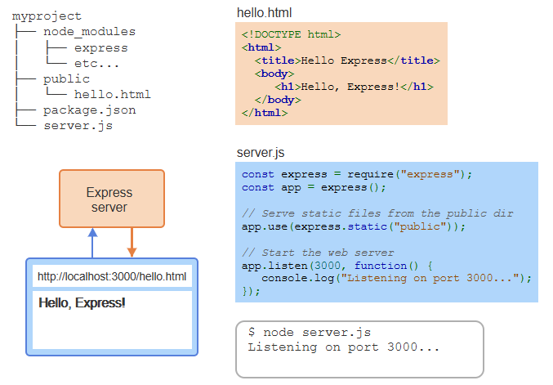
Example
Notes:
Here's an example of setting up an Express server. The project structure includes server.js where the Express server is defined, and hello.html is served from the public directory. In server dot js, we use express dot static to serve static files. The server listens on port 3000 and serves hello.html when you visit http localhost 3000 hello.html.

Slide 4
Routes
Purpose: Handle browser requests using specific URL paths and HTTP methods.
Structure: app.method(path, callback) (e.g., app.get('/', (req, res) => {...})).
Callback Function: Receives request and response objects for processing.
Notes:
Now, let's explore routes in Express. Routes are used to handle browser requests by defining specific URL paths and HTTP methods. The structure follows app dot method and then path and callback as parameter, like code shown in the slide. The callback function receives the request and response objects, which are used to process and send back the data to the browser.

Slide 5
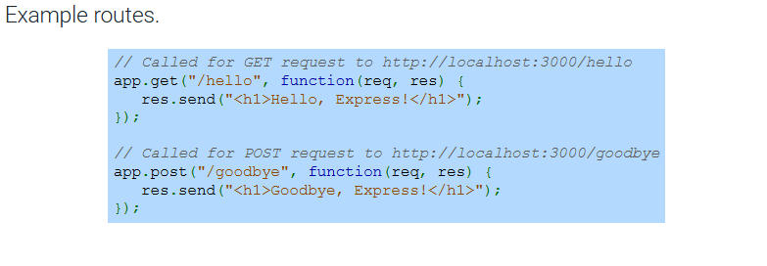
Example
Notes:
Here is an example of how to set up routes in Express. The first route handles a GET request to hello, and when accessed at http localhost 3000 hello, it sends back the message Hello, Express. The second route handles a POST request to goodbye, and when accessed at http localhost 3000 goodbye, it sends Goodbye, Express. These routes define the behavior for different HTTP methods and paths.

Slide 6
Middleware
Purpose: Examines or modifies request and response objects.
Parameters: req (request), res (response), next (callback).
Execution: Called using app.use() in Express.
Chaining: next() passes control to the next middleware in the stack.
Notes:
Now, let's discuss middleware in Express. Middleware functions are used to examine or modify the request and response objects. They receive three parameters: req (request), res (response), and next (callback). Middleware is executed using app dot use and can be chained using next to pass control to the next middleware in the stack.

Slide 7
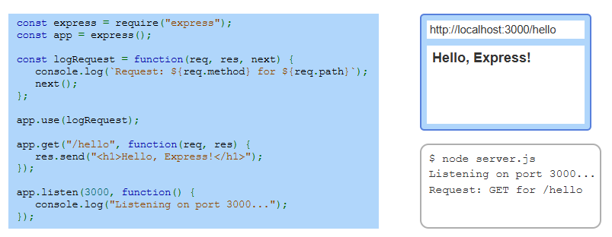
Example
Notes:
In this example, we create an Express server and set up middleware to log requests. The middleware function logs the HTTP method and path of each request. When visiting the hello route, the server responds with Hello, Express while logging the request information. The server listens on port 3000, showing how middleware can be used for logging and processing requests before reaching the route handler.

Slide 8
Third-Party Middleware
Purpose: Adds extra functionality to Express apps.
Installation: Installed via npm (e.g., npm install morgan).
Example: morgan logs details about HTTP requests.
Notes:
Now, let's talk about third party middleware. These are external tools that add extra functionality to your Express apps. For example, the morgan middleware logs details about HTTP requests, which is useful for debugging and monitoring. Third-party middleware is installed via npm, making it easy to enhance your application with minimal effort.

Slide 9
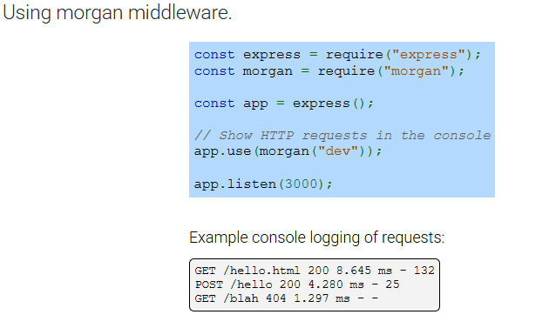
Example
Notes:
In this example, we use the morgan middleware to log HTTP requests in the console. When the server runs, it logs details such as the request method, URL, status code, and response time. For instance, a GET request to hello dot html shows the status code and time taken for the request. This is useful for monitoring and debugging your Express app.

Slide 10
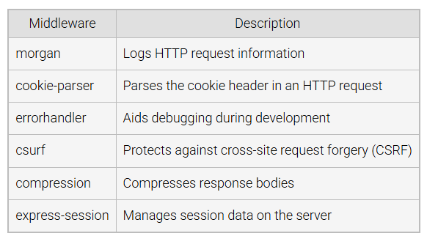
Popular Third-Party Middleware
Notes:
Here are some popular third-party middleware used in Express. Morgan logs HTTP request information. Cookie-parser parses the cookie header in an HTTP request. Error handler helps with debugging during development. C surf protects against cross-site request forgery. Compression compresses response bodies, and Express-session manages session data on the server. These tools make your Express app more secure and efficient.

